Slide 1
PROJECT - TEJUS GRAND
Part 1

Slide 2
Presented by : Team-3
Role : Jr.Software engineer
Organization : Anarghya
communications

Slide 3
contains
Landing page
Registration page
Login page
Contact us page
JAVA SCRIPT
BOOSTRAP

Slide 4
WEB PAGE
<!DOCTYPE html>: This declaration defines the document type and version of HTML being used (HTML5 in this case).
<html>: This is the root element that wraps the entire HTML content.
<head>: This section contains meta-information about the page, such as the title that appears in the browser tab.
<title>: Sets the title of the web page, which is displayed in the browser tab.
<body>: This section contains the visible content of the web page.
<header>: Typically contains introductory content, like the main heading or logo.
<nav>: Contains navigation links or menus.
<ul> and <li>: Create an unordered list with list items.
<a>: Defines hyperlinks (links) to other pages or resources.
<main> : Holds the main content of the web page.
<section>: Divides the content into sections, each with its own heading.
<footer>: Contains footer information, often copyright notices or contact details.
<p>: Represents paragraphs of text.
css
There are many css tags are used in web page these are tags are pre defined
some examples are margins ,headers, display, align items, background
font family, text align e.t.c

Slide 5
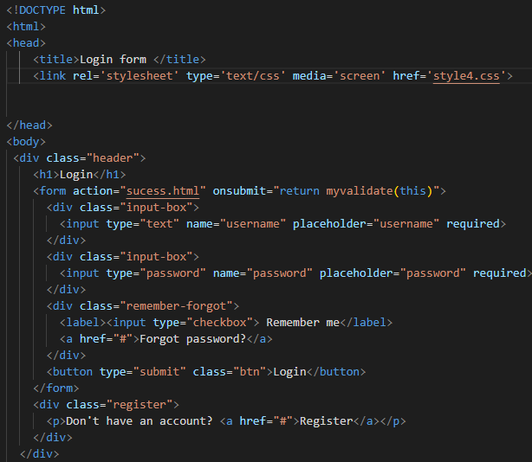
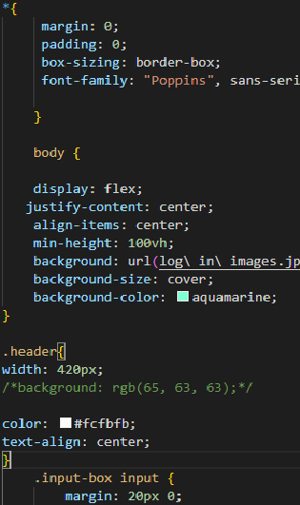
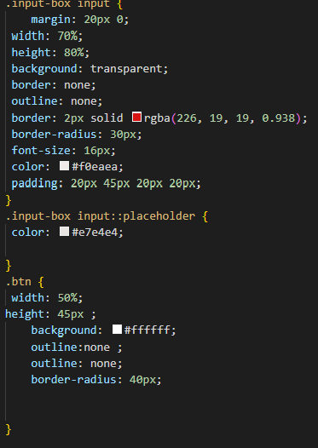
HTML
CSS
THIS IS THE CODE FOR LOG IN PAGE

Slide 6
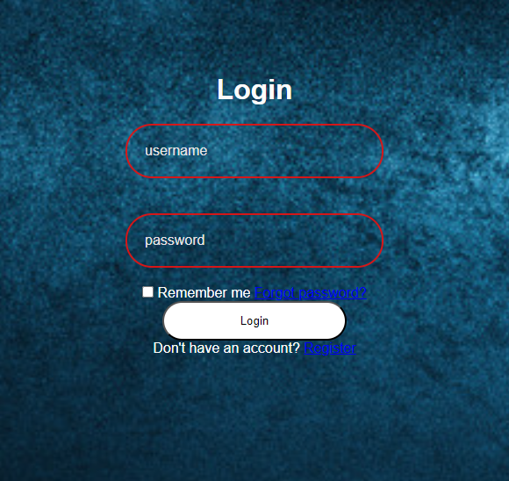
LOG IN PAGE

Slide 7
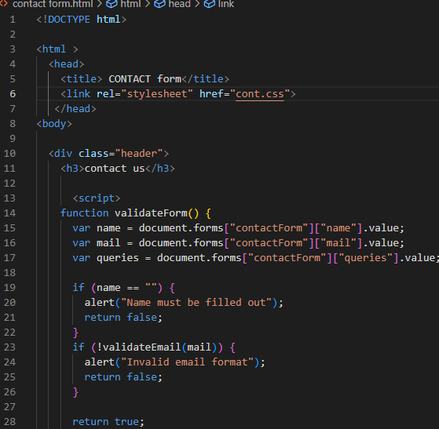
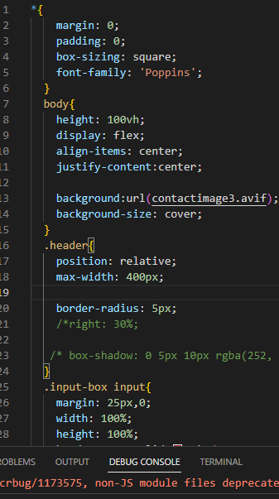
CONTACT US CODE

Slide 8
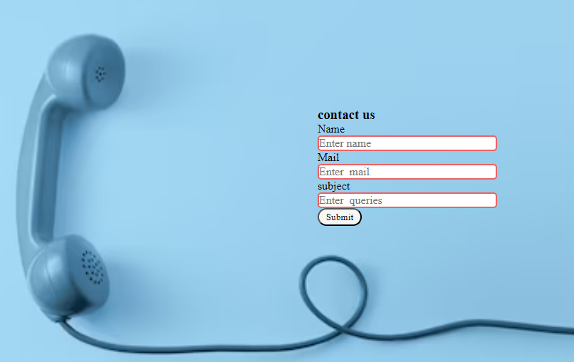
1.Landing page
In the contact us page we can submit our issues to the particular organization by our submitting our mail id and name as the inputs and . Header class contains contact us . Below that we added the text are we need to add name of the person and mail id in the next column
In the landing page we created an interface where links are provided for each section separately and also added features to it.
CONTACT US

Slide 9
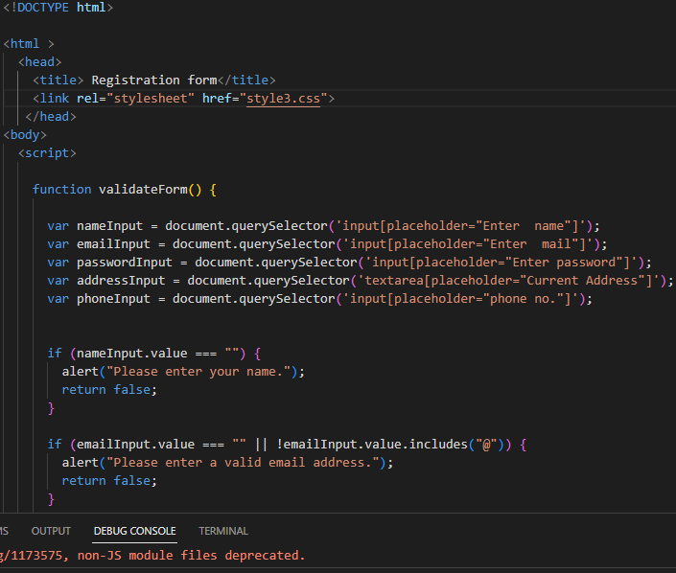
3.Registration page
We had connected the Registration page in side the landing page . To make it responsive by using plain html and Css . And also user inputs are added to insert the data.
REGISTRATION CODE

Slide 10
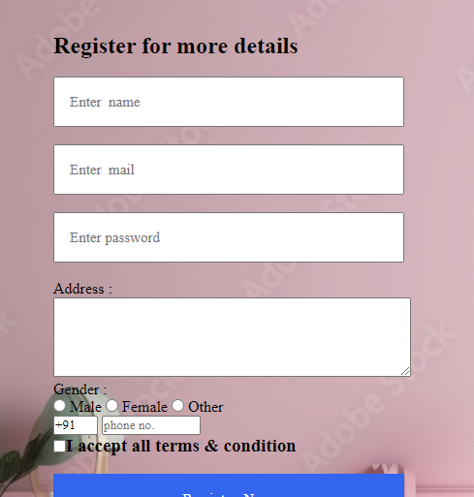
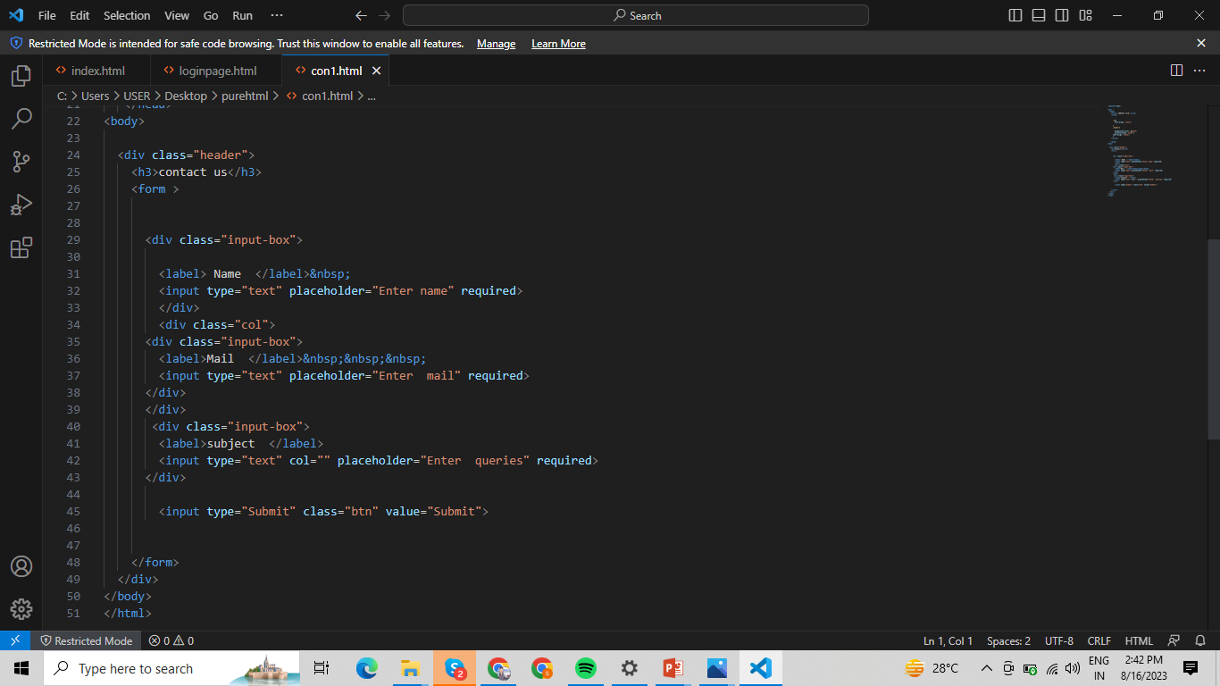
4. Contact us page
In the contact us page we can submit our issues to the particular organization by our submitting our mail id and name as the inputs and . Header class contains contact us . Below that we added the text are we need to add name of the person and mail id in the next column .

Slide 11
landing page out put
By adding all the pages we created a landing page .
Which is the main page and medium to the many other pages
In the main page out put we are using multi functions
The functions are
HTML
CSS
HTML 5
CSS 3
JAVASCRIPT
MEDIA QUERIES
BOOSTRAP ………… THE OUT PUT ARE SHOWN IN BELOW IMAGE

Slide 12

landing page out put
Aftet using the HTML and CSS AND JAVA SCRIPT the out is shown in below.

Slide 13
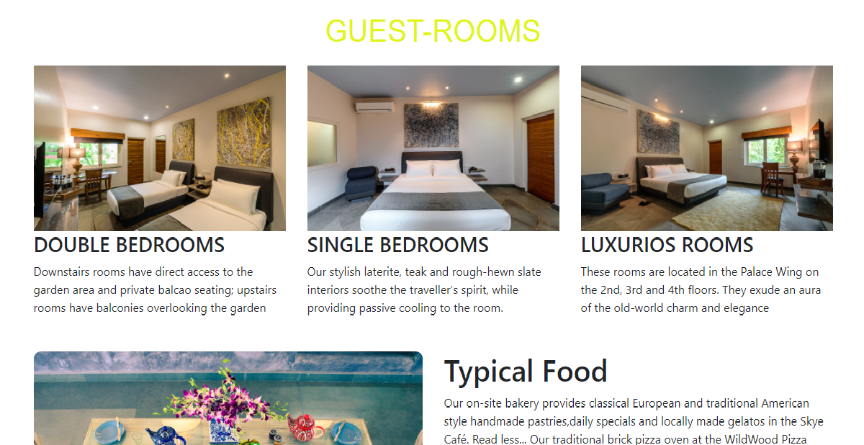

Slide 14
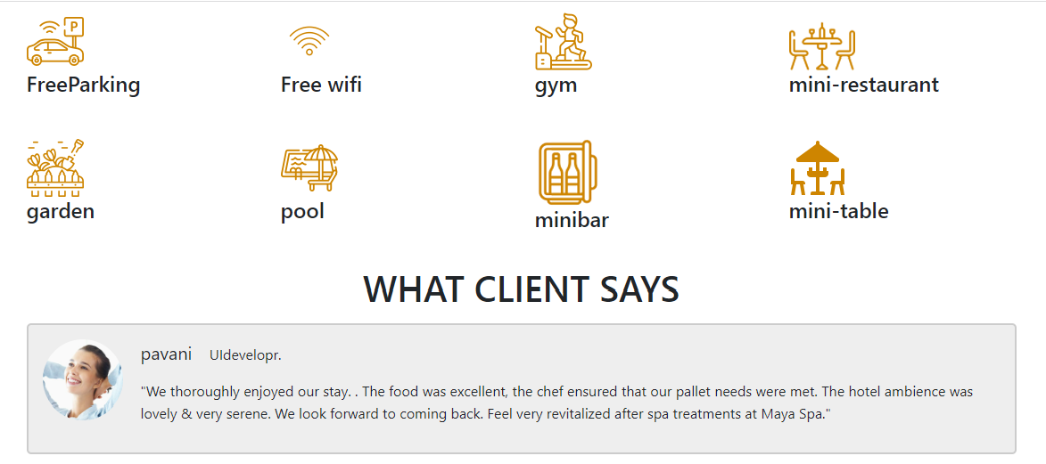
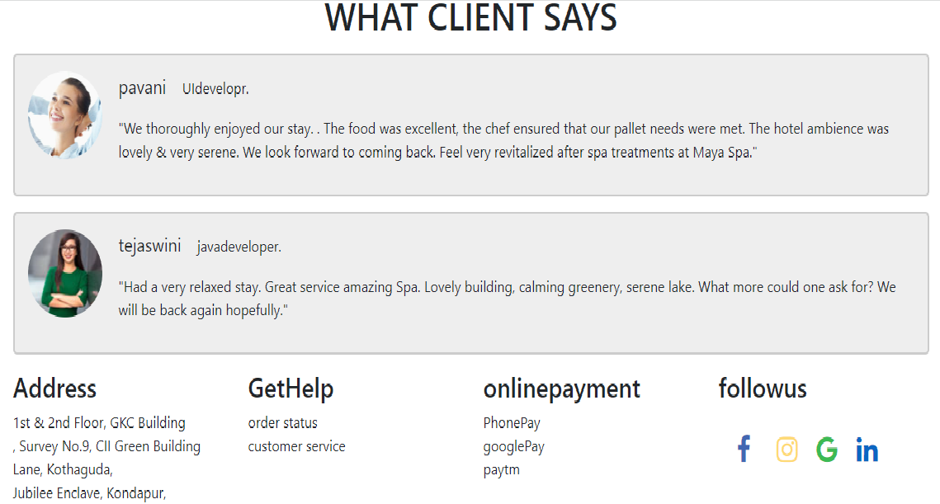

Slide 15
THANK YOU

